Slide 1
Final Project
CUSTOMER CHURN PROJECT
Presented by
Krishna Prasath V
MBE5 Batch

Slide 2
It sounds like you have a comprehensive plan in place to tackle the customer churn issue for the telecommunications company. Here's how you can approach each of the questions:
1. Primary Factors Influencing Customer Churn: Start by performing exploratory data analysis (EDA) to understand the distribution of variables and identify any patterns or correlations. Utilize techniques such as correlation analysis, feature importance ranking, and data visualization to identify which factors have the strongest influence on churn. Additionally, you can employ machine learning algorithms like decision trees or random forests to uncover non-linear relationships and interactions between variables.
2. Demographic and Behavioral Characteristics of Churned Customers: Segment the customer base based on demographic variables such as age, gender, income, etc., and behavioral characteristics such as usage patterns, complaints, customer service interactions, etc. Compare these segments to identify differences between churned and active customers. Techniques like cluster analysis or decision trees can help in identifying characteristic profiles of churned customers.
3. Specific Services or Contract Terms Contributing to Churn: Analyze the relationship between different services (e.g., internet, phone, TV) and contract terms (e.g., contract length, pricing) with customer churn. Utilize statistical tests or machine learning models to quantify the impact of each service or contract term on churn probability. Additionally, conduct customer surveys or interviews to gather qualitative insights on service satisfaction and identify areas for improvement.

Slide 3
4. Building a Predictive Model for Customer Churn: Split the dataset into training and testing sets, and apply machine learning algorithms such as logistic regression, decision trees, random forests, or gradient boosting to build predictive models for customer churn. Evaluate the performance of these models using metrics like accuracy, precision, recall, and ROC-AUC. Utilize techniques like feature selection or dimensionality reduction to identify the key features contributing to the predictive accuracy of the model.
Throughout the project, ensure to validate findings and insights through rigorous statistical analysis and, if possible, conduct A/B testing or pilot programs to assess the effectiveness of proposed retention strategies. By integrating data analytics techniques with domain knowledge and business context, you can provide actionable recommendations to the telecommunications company for improving customer retention and reducing churn.

Slide 4
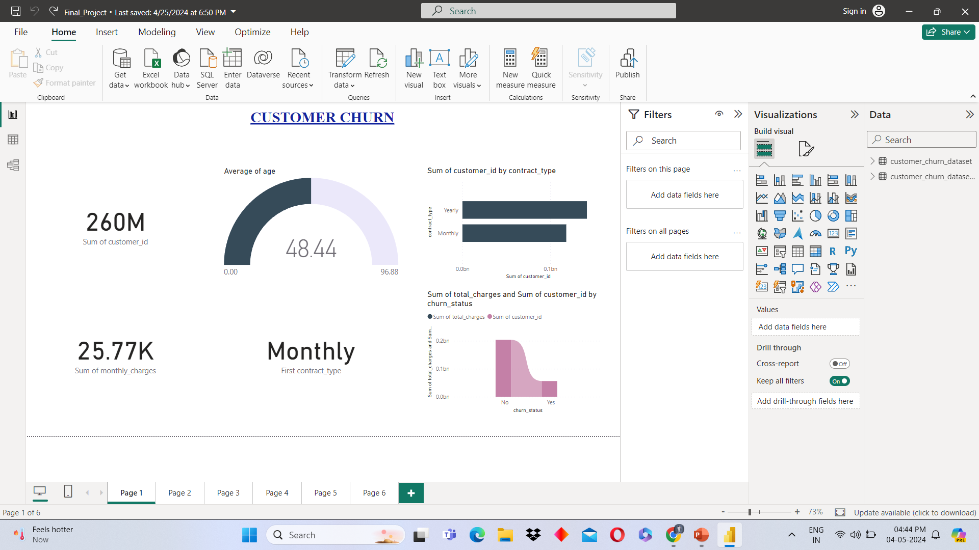
Identify the total number of customers and the churn rate
2. Find the average age of churned customers

Slide 5

3. Discover the most common contract types among churned customers
4. Analyze the distribution of monthly charges among churned customers

Slide 6
5. Create a query to identify the contract types that are most prone to churn
6. Identify customers with high total charges who have churned

Slide 7
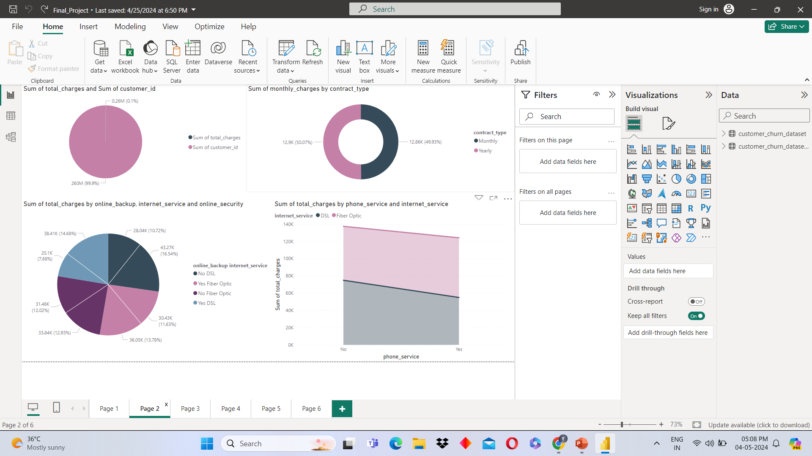
7. Calculate the total charges distribution for churned and non-churned customers
8. Calculate the average monthly charges for different contract types among churned customers

Slide 8
9. Identify customers who have both online security and online backup services and have not churned
10. Determine the most common combinations of services among churned customers

Slide 9
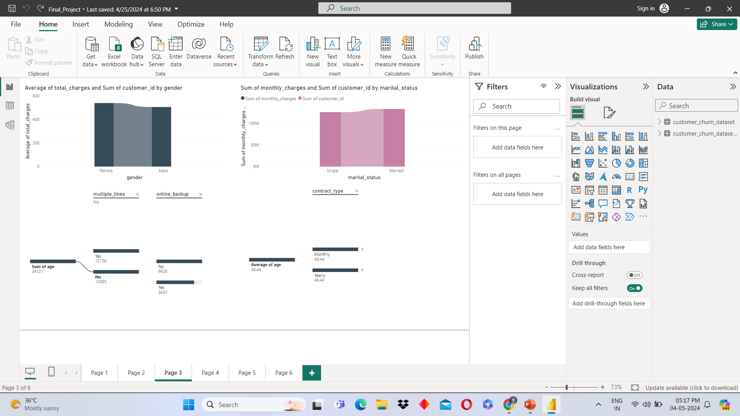
11. Identify the average total charges for customers grouped by gender and marital status
12. Calculate the average monthly charges for different age groups among churned customers

Slide 10
13. Determine the average age and total charges for customers with multiple lines and online backup
14. Identify the contract types with the highest churn rate among senior citizens (age 65 and over)

Slide 11
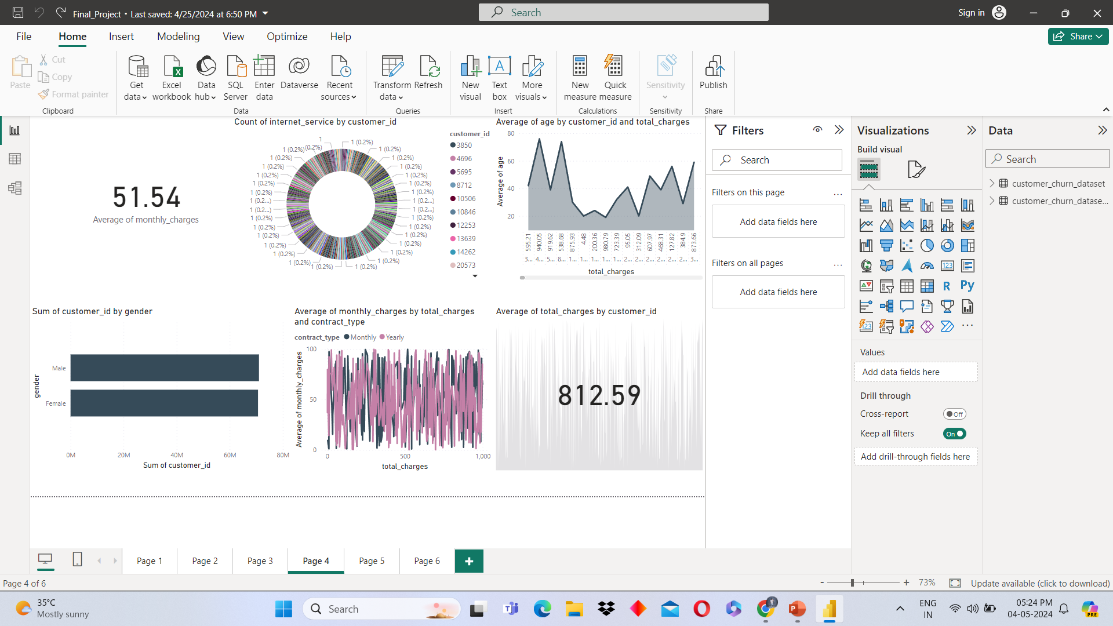
15. Calculate the average monthly charges for customers who have multiple lines and streaming TV
16. Identify the customers who have churned and used the most online services

Slide 12
17. Calculate the average age and total charges for customers with different combinations of streaming services
18. Identify the gender distribution among customers who have churned and are on yearly contracts

Slide 13
19. Calculate the average monthly charges and total charges for customers who have churned, grouped by contract type and internet service type
20. Find the customers who have churned and are not using online services and their average total charges

Slide 14
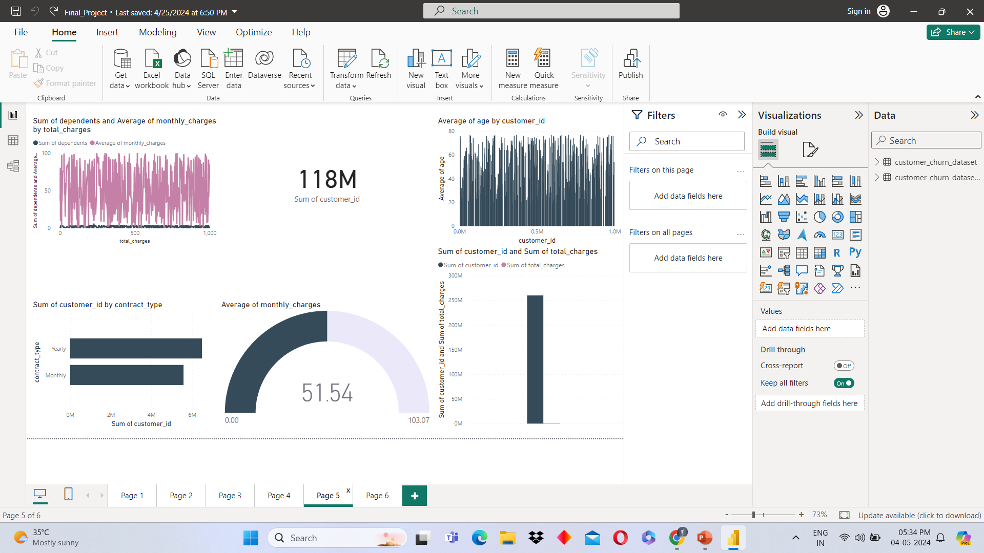
21. Calculate the average monthly charges and total charges for customers who have churned, grouped by the number of dependents
22. Identify the customers who have churned, and their contract duration in months (for monthly contracts)

Slide 15
23. Determine the average age and total charges for customers who have churned, grouped by internet service and phone service
24. Create a view to find the customers with the highest monthly charges in each contract type

Slide 16
25. Create a view to identify customers who have churned and the average monthly charges compared to the overall average
26. Create a view to find the customers who have churned and their cumulative total charges over time

Slide 17
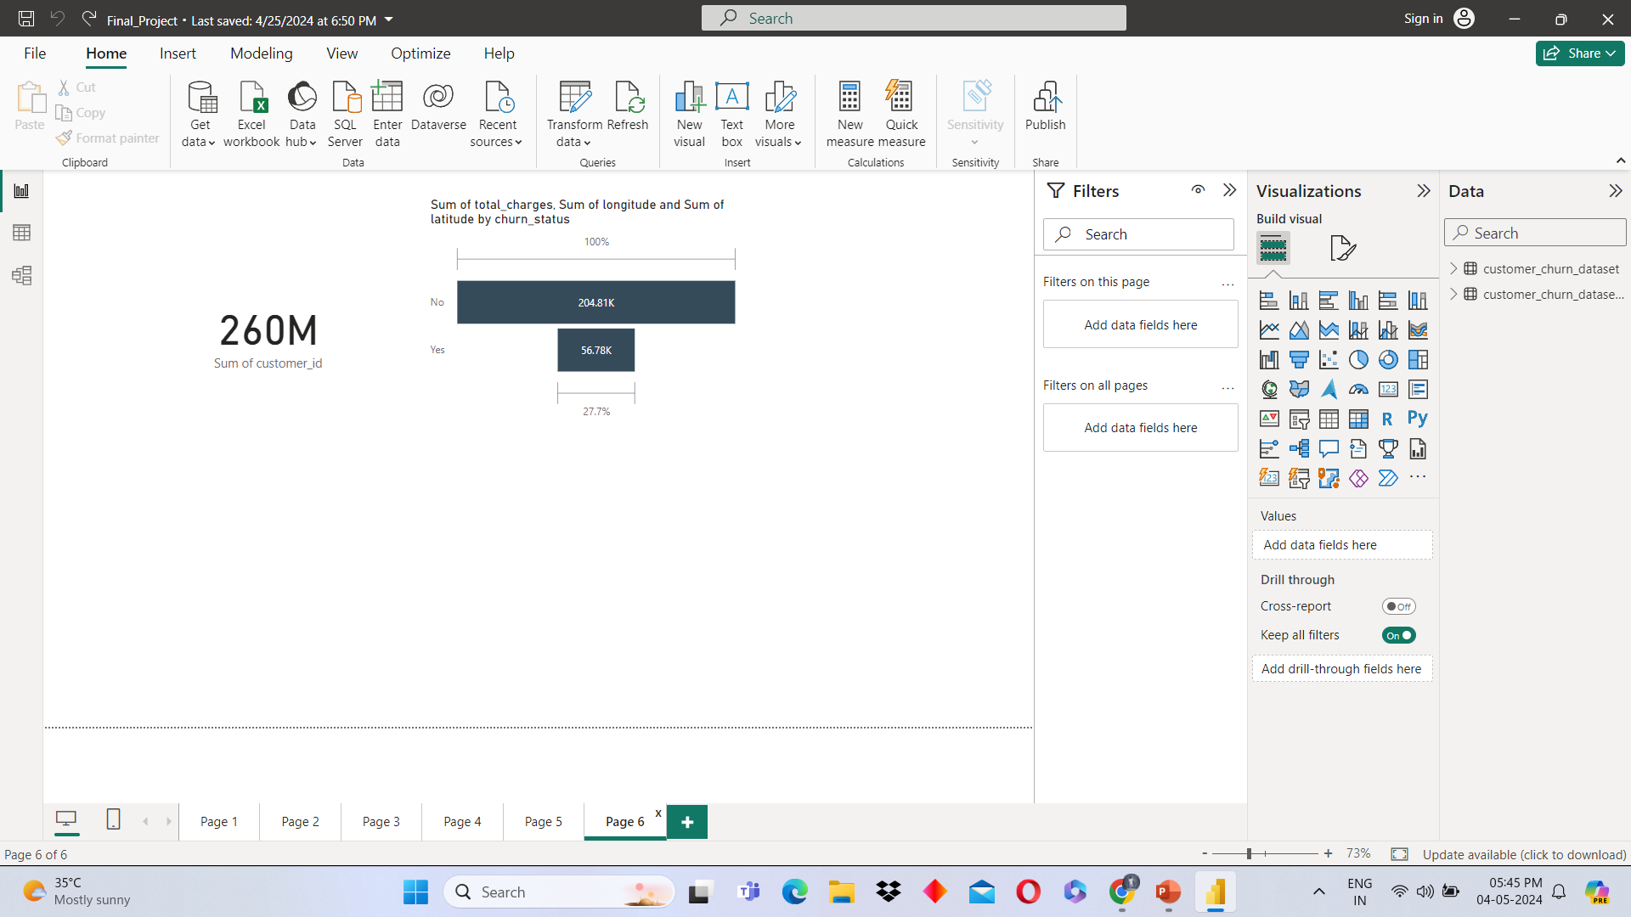
27. Stored Procedure to Calculate Churn Rate
28. Stored Procedure to Identify High-Value Customers at Risk of Churning

Slide 18
Thank You

